Slide 1


CatCat-Tickets-Chatbots
by octofox

Slide 2
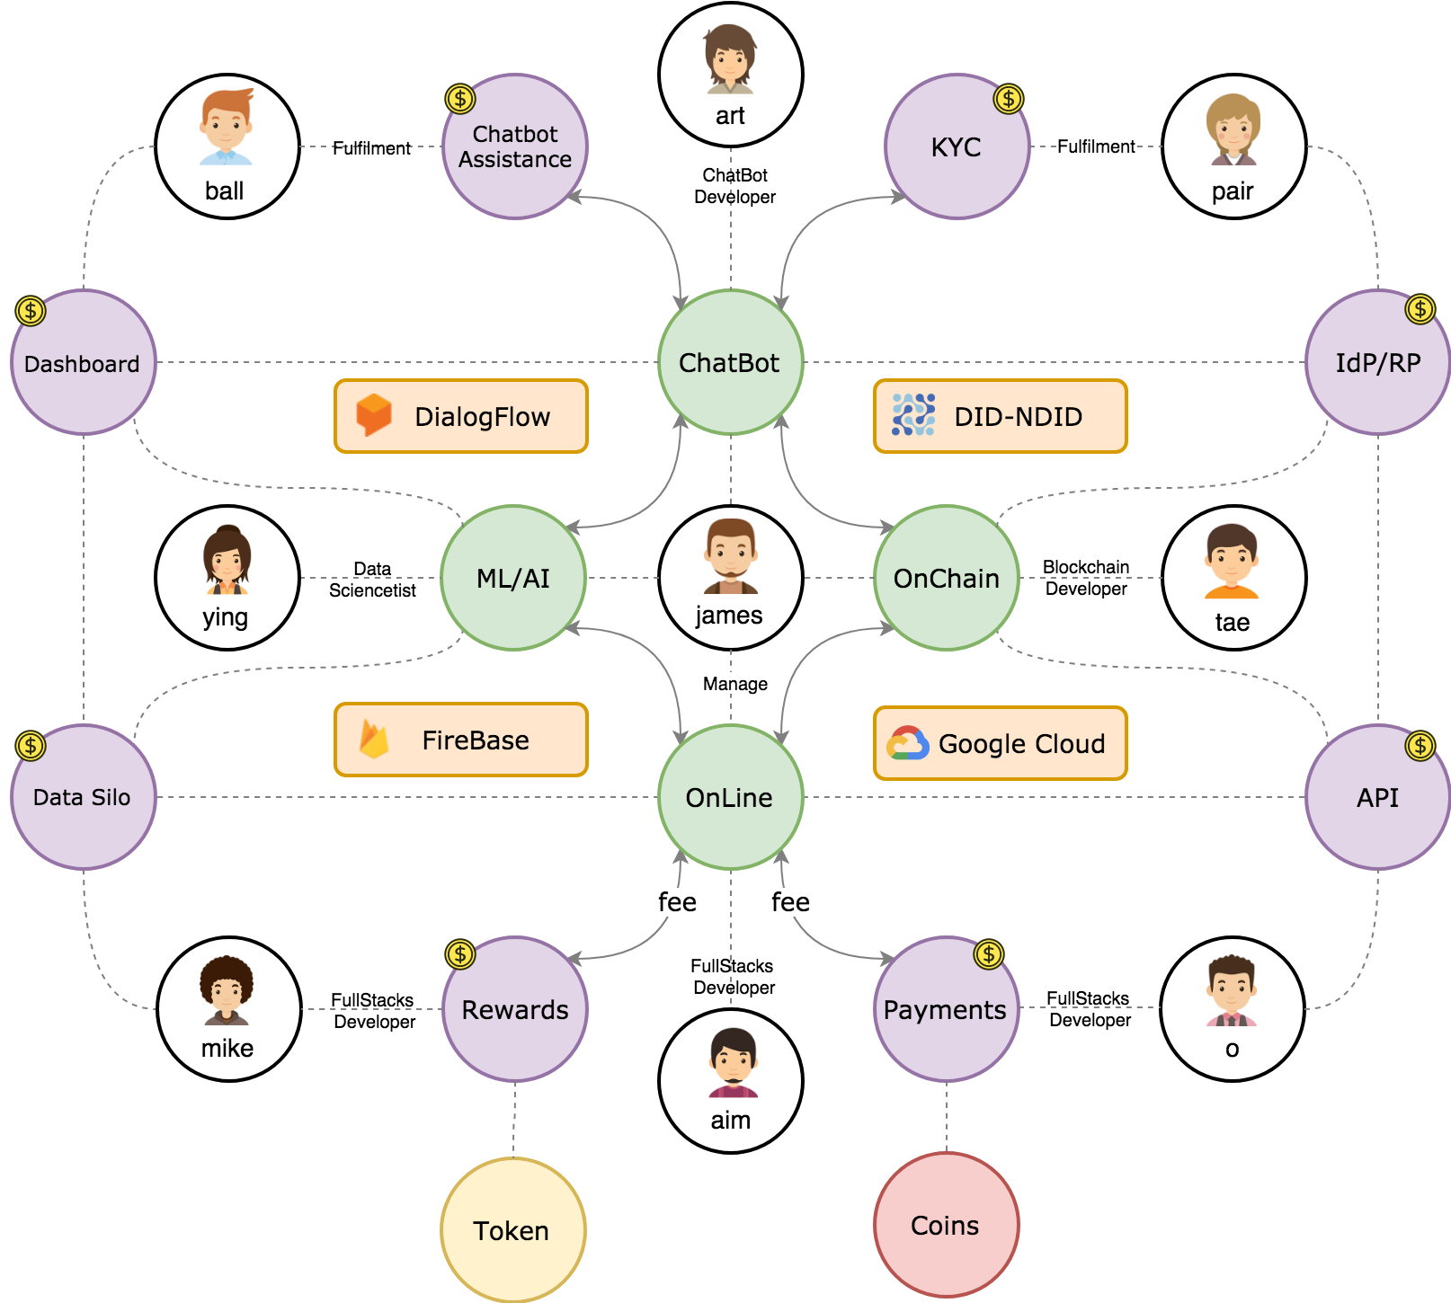
Company Overview
We are Blockchain Developer company.
We currently use Stellar
for public Blockchain.
Hyperledger Fabric
for permission Blockchain.
Chatbots as User Interface.
ML for classification and segmentations.
We also looking forward to use LINK token.

Slide 3
Business Objective
For short term,
We are trying to bring Blockchain to mainstream by using Chatbots as interface and use tickets as MVP product.
For long term,
We will promote tickets platform to Tokenization Assets As a Services and connect it with our payments gateway partner including Stellar and LINK.

Slide 4
Business Requirement
For the system to be developed according to the clients demand. Details are below:
Target:
Users : 100,000 friends
API:
Messaging API
LINE pay API
LINK API

Slide 5
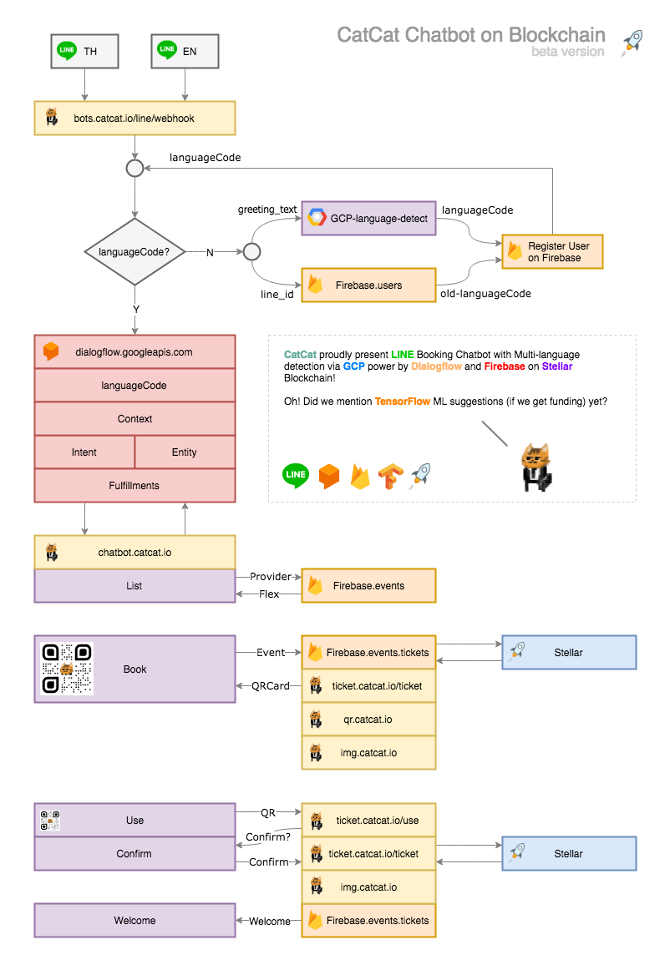
Wireframe

Slide 6
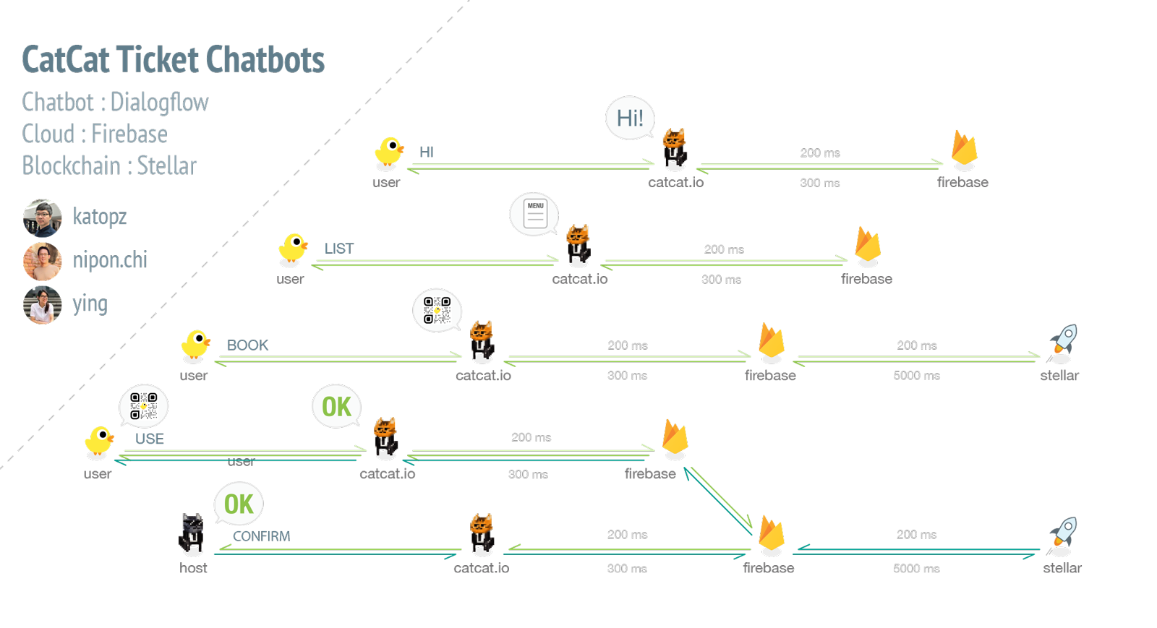
Flow

Slide 7
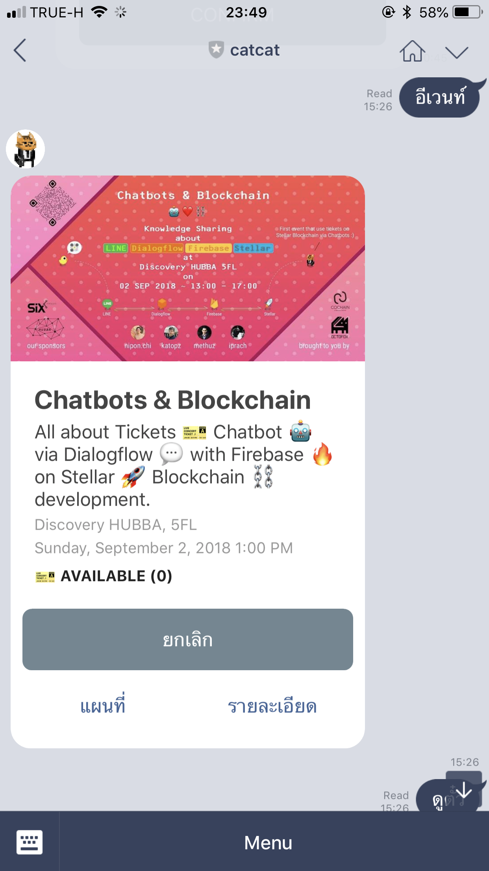

Slide 8
MVP
Working example
We host an events
then use our chatbots
to provide tickets
on Blockchain

Slide 9
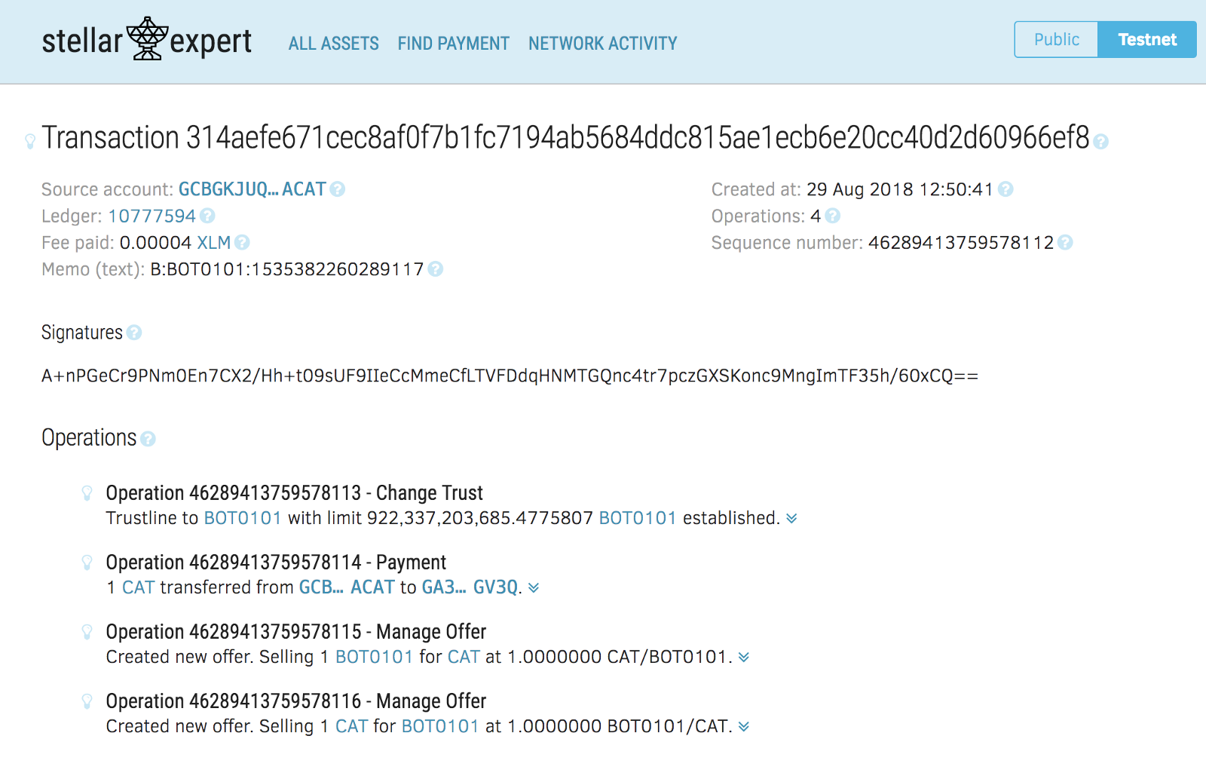
The tickets on Stellar Blockchain via LINE Chatbots

Slide 10
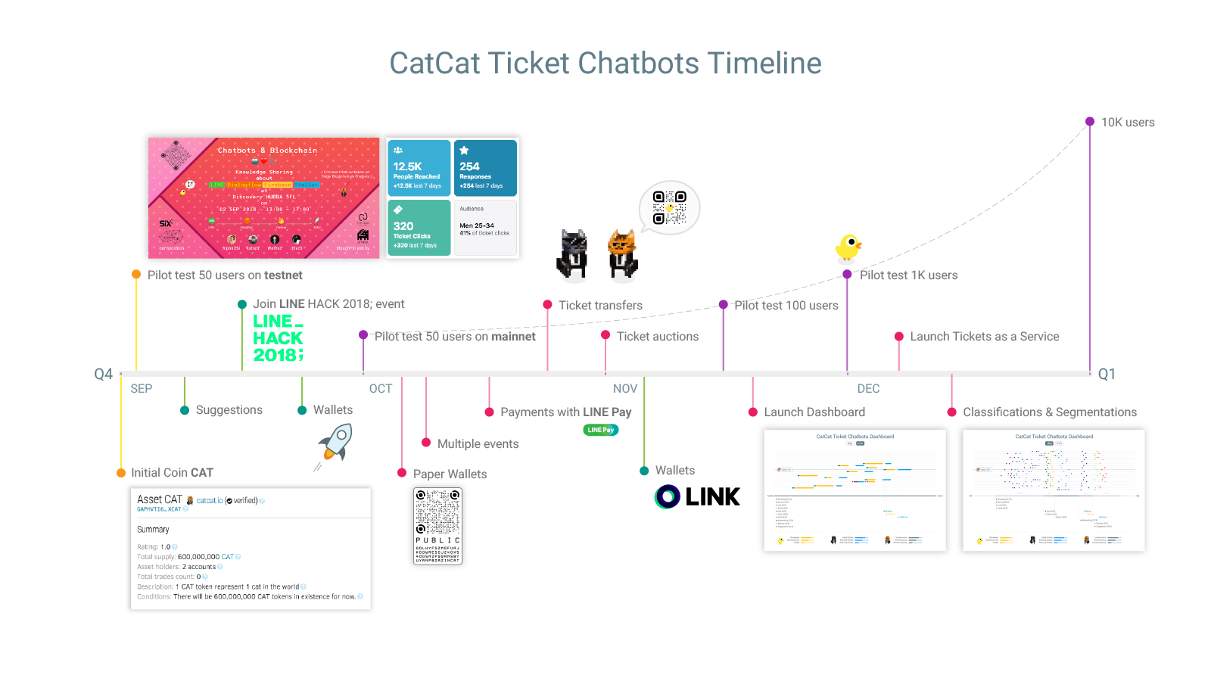

Slide 11
Why Chatbots
Frictionless onboard experiences : No app download required
Familiar Conversation UI : No tutorials required
Bi-direction connections between producer and consumer
Can notify and instantly gathering feedback
Can use web view for complex tasks

Slide 12
Why Blockchain
Transparency digital assets values store
Securely and trustable distributed ledger
Exchangeable assets between user and also with other chains

Slide 13
Why Stellar
Cheap : 0.00001 XLM = $0.0000025
Fast : ~5 sec
Secure : FBFT, Quorums slice
Solid : Use by IBM
Open : Open Source
Easy : Rest-API

Slide 14
The Team
We already start fixing problems we identified, and there’s no turning back :)
Todsaporn
Banjerdkit
Nipon Chinathimatmongkhon
Manusaporn Treerungroj
Niwat
Chatawittayakul
Designer
Simply designs is my key
Developer
I only build solid platforms
Data Engineer
Data is my treasures :)
Marketer
Let’s do the biz!

Slide 15
Revenue model
- From payments fees
- From tickets fees
- From tickets swap fees
- From Data Silo
- From Tokenize as a Services
- From KYC as a Services
- From subscriptions
- From LINK Token value
- From Blockchain course

Slide 16
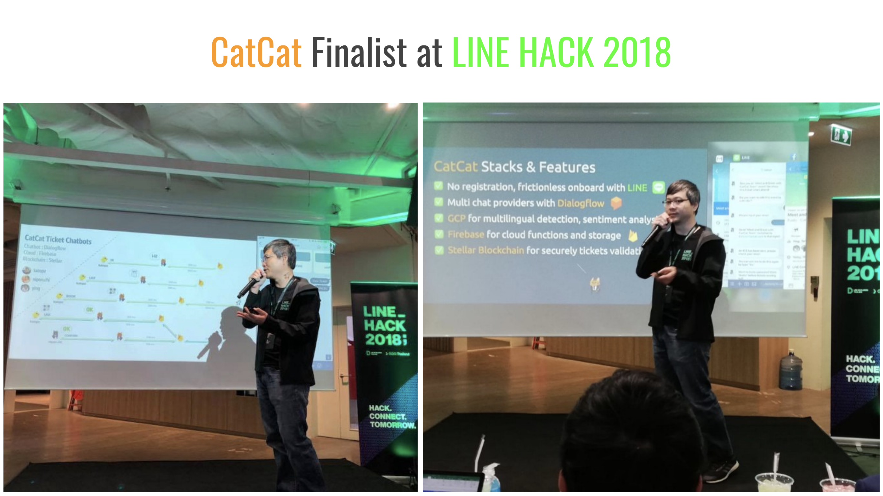

Slide 17
